Slide 1
HNDIT11062 – Web Development
Week 8: HTML Basics 2

Slide 2
Lists
In this chapter you will learn how to create a variety of lists.
Objectives
Upon completing this section, you should be able to
Create an unordered list.
Create an ordered list.
Create a defined list.
Nest Lists.

Slide 3
List Elements
HTML supplies several list elements. Most list elements are composed of one or more <LI> (List Item) elements.
UL : Unordered List: Items in this list start with a list mark such as a bullet. Browsers will usually change the list mark in nested lists.
<UL>
<LI> List item …</LI>
<LI> List item …</LI>
</UL>
List item …
List item …

Slide 4
List Elements
You have the choice of three bullet types: disc(default), circle, square.
These are controlled in Netscape Navigator by the “TYPE” attribute for the <UL> element.
<UL TYPE=“square”>
<LI> List item …</LI>
<LI> List item …</LI>
<LI> List item …</LI>
</UL>
List item …
List item …
List item …

Slide 5
List Elements
OL: Ordered List: Items in this list are numbered automatically by the browser.
<OL>
<LI> List item …</LI>
<LI> List item …</LI>
<LI> List item …</LI>
</OL>
1. List item …
2. List item …
3. List item …
You have the choice of setting the TYPE Attribute to one of five numbering styles.

Slide 6
List Elements
TYPE | Numbering | Styles
1 | Arabic numbers | 1,2,3, ……
a | Lower alpha | a, b, c, ……
A | Upper alpha | A, B, C, ……
i | Lower roman | i, ii, iii, ……
I | Upper roman | I, II, III, ……

Slide 7
List Elements
You can specify a starting number for an ordered list.
<OL TYPE =“i”>
<LI> List item …</LI>
<LI> List item …</LI>
</OL>
<P> text ….</P>
<OL TYPE=“i” START=“3”>
<LI> List item …</LI>
</OL>

Slide 8
List Elements
List item …
List item …
Text ….
List item …

Slide 9
List Elements
DL: Definition List: This kind of list is different from the others. Each item in a DL consists of one or more Definition Terms (DT elements), followed by one or more Definition Description (DD elements).
<DL>
<DT> HTML </DT>
<DD> Hyper Text Markup Language </DD>
<DT> DOG </DT>
<DD> A human’s best friend!</DD>
</DL>
HTML
Hyper Text Markup Language
DOG
A human’s best friend!

Slide 10
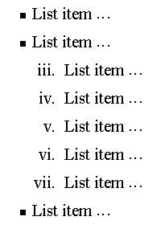
Nesting Lists
You can nest lists by inserting a UL, OL, etc., inside a list item (LI).
Example
<UL TYPE = “square”>
<LI> List item …</LI>
<LI> List item …
<OL TYPE=“i” START=“3”>
<LI> List item …</LI>
<LI> List item …</LI>
<LI> List item …</LI>
<LI> List item …</LI>
<LI> List item …</LI>
</OL>
</LI>
<LI> List item …</LI>
</UL>

Slide 11
What will be the output?
<H1 ALIGN="CENTER">SAFETY TIPS FOR CANOEISTS</H1>
<OL TYPE=“a” START=“2”>
<LI>Be able to swim </LI>
<LI>Wear a life jacket at all times </LI>
<LI>Don't stand up or move around. If canoe tips,
  <UL>
  <LI>Hang on to the canoe </LI>
  <LI>Use the canoe for support and </LI>
  <LI>Swim to shore
  </UL> </LI>
<LI>Don't overexert yourself </LI>
<LI>Use a bow light at night </LI>
</OL>

Slide 12
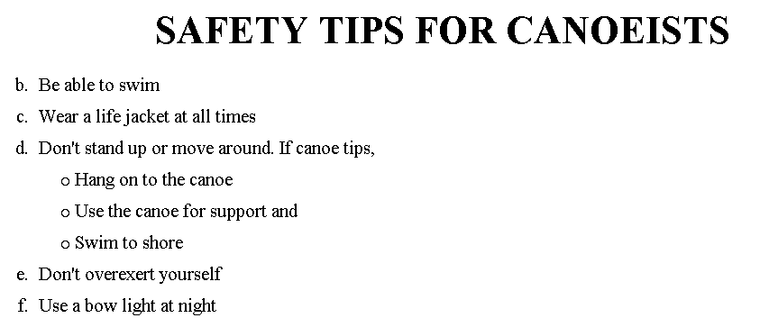
The output….

Slide 13
<H1 ALIGN="CENTER">SAFETY TIPS FOR CANOEISTS</H1>
<OL TYPE="a" START="2">
<LI>Be able to swim </LI>
<LI>Wear a life jacket at all times </LI>
<LI>Don't stand up or move around. If canoe tips,
<UL>
<LI>Hang on to the canoe </LI>
<LI>Use the canoe for support
<OL type="I" start="4">
<LI> Be careful </LI>
<LI> Do not look around</LI>
</LI> </OL>
<LI>Swim to shore
</UL> </LI>
<LI>Don't overexert yourself </LI>
<LI>Use a bow light at night </LI>
</OL>
What
will
be the
output?

Slide 14
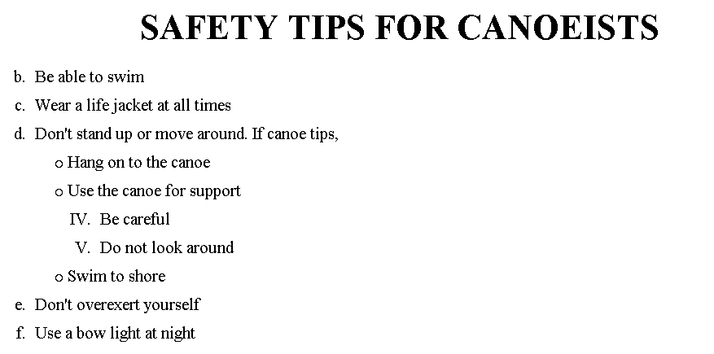
The output….

Slide 15
Images
In this chapter you will learn about images and how to place images in your pages.
Objectives
Upon completing this section, you should be able to
Add images to your pages.

Slide 16
Images
<IMG>This element defines a graphic image on the page.
Image File (SRC:source): This value will be a URL (location of the image)
E.g. http://www.domain.com/dir/file.ext or /dir/file.txt
Alternate Text (ALT): This is a text field that describes an image or acts as a label. It is displayed when they position the cursor over a graphic image.
Alignment (ALIGN): This allows you to align the image on your page.

Slide 17
Images
Width (WIDTH): is the width of the image in pixels.
Height (HEIGHT): is the height of the image in pixels.
Border (BORDER): is for a border around the image, specified in pixels.
HSPACE: is for Horizontal Space on both sides of the image specified in pixels. A setting of 5 will put 5 pixels of invisible space on both sides of the image.
VSPACE: is for Vertical Space on top and bottom of the image specified in pixels. A setting of 5 will put 5 pixels of invisible space above and bellow the image.

Slide 18
Some Examples on images
1) <IMG SRC=“jordan.gif“ border=4>
2) <IMG SRC=" jordan.gif" width="60" height="60">
3) <IMG SRC=“jordan.gif" ALT="This is a text that goes with the image">
4) <IMG SRC=" jordan.gif “ Hspace="30" Vspace="10" border=20>
5) < IMG SRC =" jordan.gif“ align="left">
blast blast blast blast blast

Slide 19
Anchors, URLs and Image Maps
In this chapter you will learn about Uniform Resource Locator, and how to add them as Anchor or Links inside your web pages.
Objectives
Upon completing this section, you should be able to
Insert links into documents.
Define Link Types.
Define URL.
List some commonly used URLs.
Plan an Image Map.

Slide 20
HOW TO MAKE A LINK
The tags used to produce links are the <A> and </A>.
The <A> tells where the link should start and
the </A> indicates where the link ends.
Everything between these two will work as a link.
2) The example below shows how to make the word Here work as a link to yahoo.
Click <A HREF="http://www.yahoo.com">here</A> to
go to yahoo.

Slide 21
More on LINKs
<body LINK="#C0C0C0" VLINK="#808080" ALINK="#FF0000">
LINK - standard link - to a page the visitor hasn't been to yet. (standard color is blue - #0000FF).
VLINK - visited link - to a page the visitor has been to before. (standard color is purple - #800080).
ALINK - active link - the color of the link when the mouse is on it. (standard color is red - #FF0000).
If the programmer what to change the color
Click <a href="http://www.yahoo.com"><font color="FF00CC">here</font></a> to go to yahoo.

Slide 22
Internal Links
Internal Links : Links can also be created inside large documents to simplify navigation. Today’s world wants to be able to get the information quickly. Internal links can help you meet these goals.
Select some text at a place in the document that you would like to create a link to, then add an anchor to link to like this:
<A NAME=“bookmark_name”></A>
The Name attribute of an anchor element specifies a location in the document that we link to shortly. All NAME attributes in a document must be unique.
Next select the text that you would like to create as a link to the location created above.
<A HREF=“#bookmark_name”>Go To Book Mark</A>

Slide 23
E-Mail (Electronic Mail)
E.g. mailto:kmf@yahoo.com
The type of service is identified as the mail client program. This type of link will launch the users mail client.
The recipient of the message is kmf@yahoo.com
<A HREF=“mailto:kmf@yahoo.com”>Send me
More Information </A>

